Slide 1
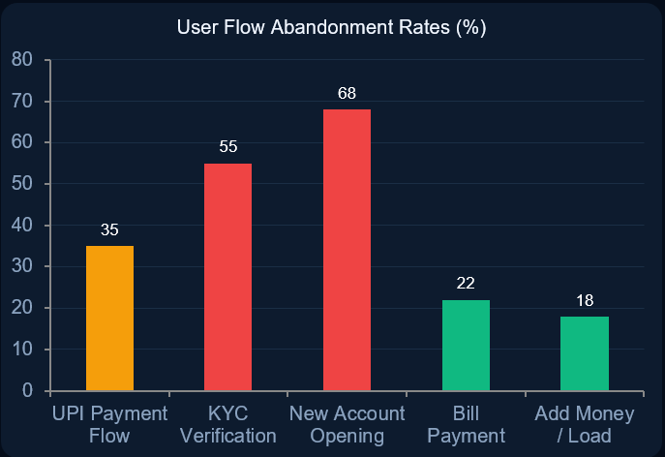

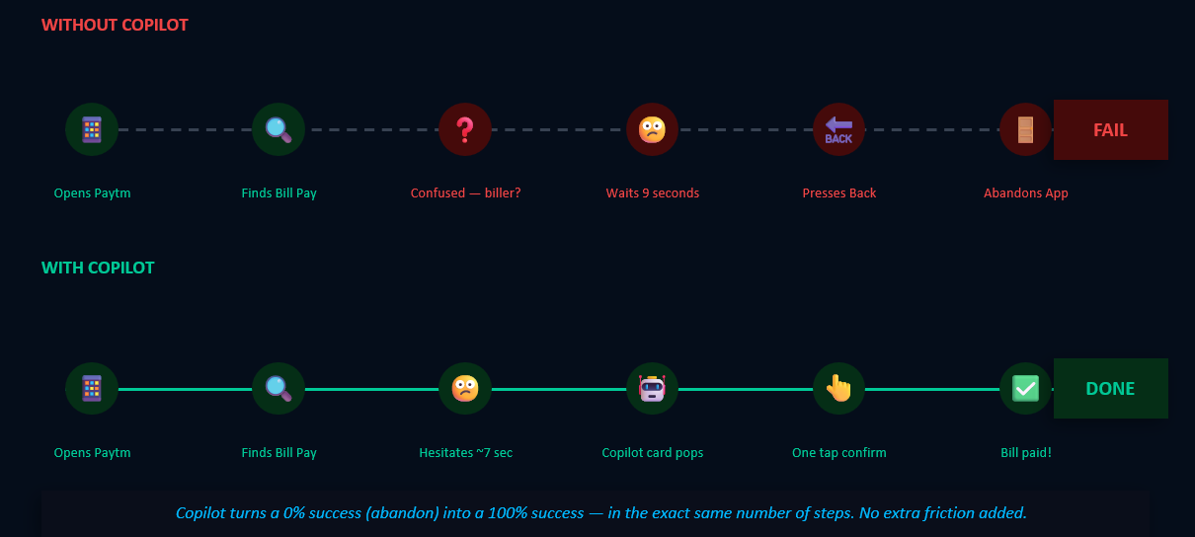
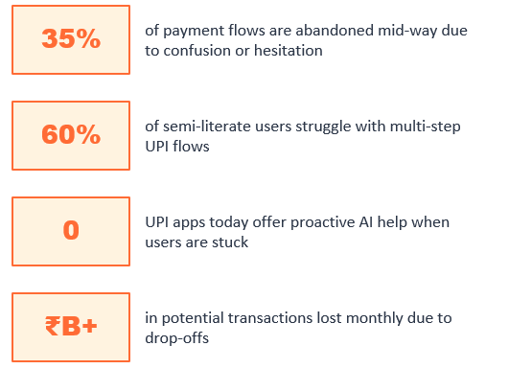
Paytm Copilot
FIN-O-HACK
fintech hackathon
Problem Track -
AI for Paytm Users
Problem -
35% of payment flows are abandoned mid-way — because Paytm watches but never helps.
Solution -
We gave Paytm a brain — one that watches, learns, and acts so users never get stuck again.
Team - Paythis
Avinish Kumar Mahato (DTU)
Deepanshu Meena (DTU)

Slide 2
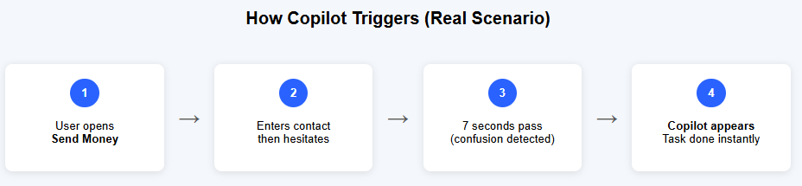
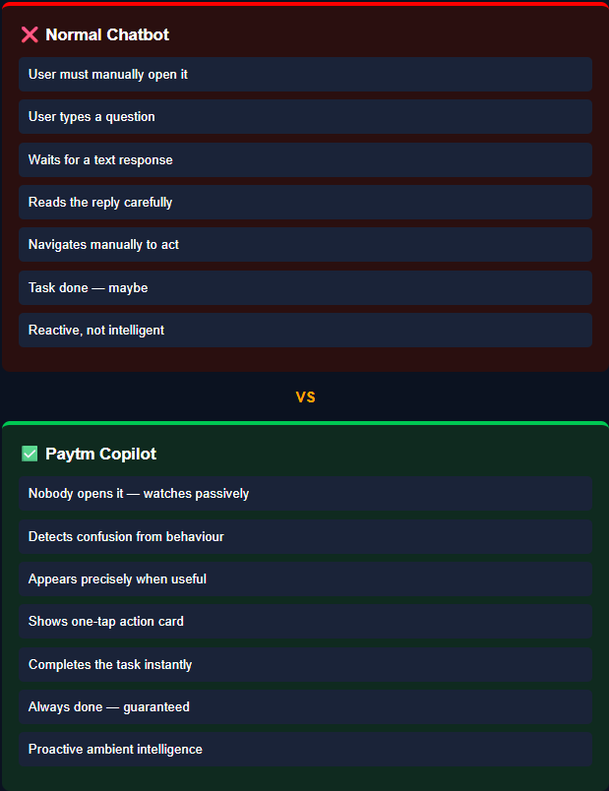
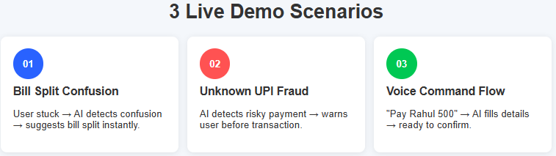
Solution: What is Paytm Copilot:
An invisible AI layer inside Paytm that watches what you're doing, understands your intent, and proactively offers to complete the task — in one tap
● GPS doesn't wait for you to ask "which turn?" It watches and speaks before you need it. Copilot is GPS — for every screen in Paytm.
Watches, Understands, Acts — before you even ask.

Slide 3
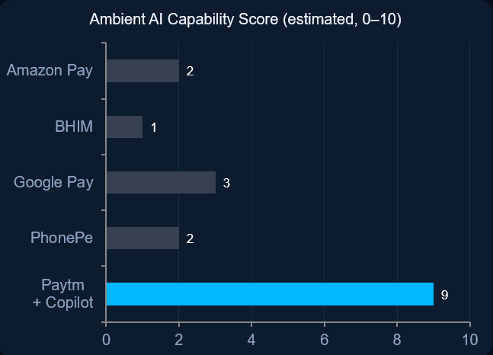
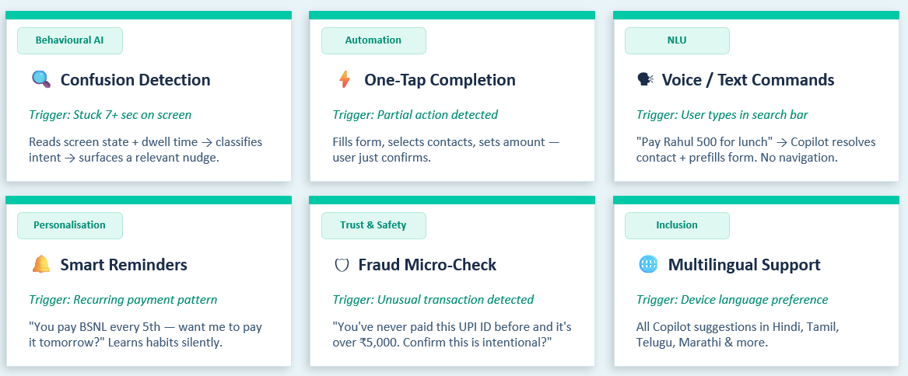
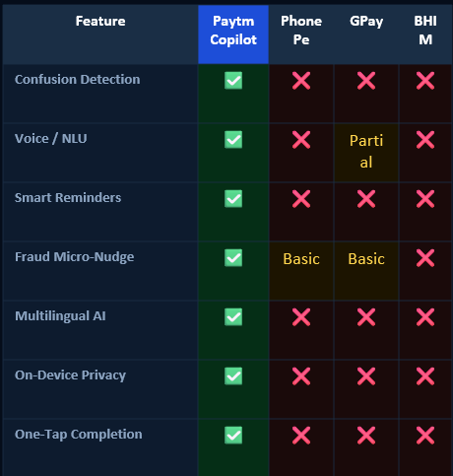
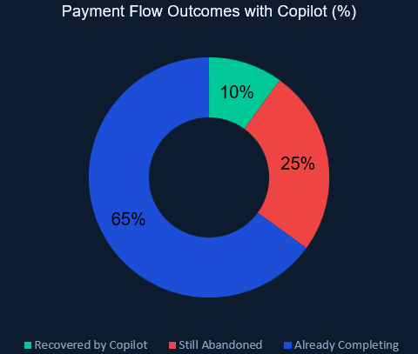
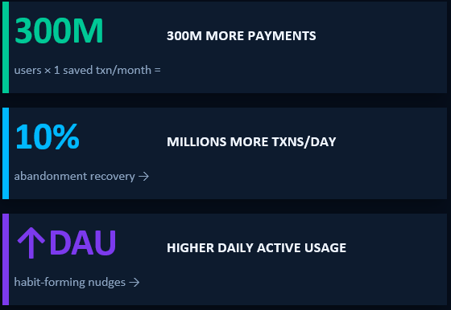
Features: What Copilot Does
The Features — Built for 300M Users

Slide 4
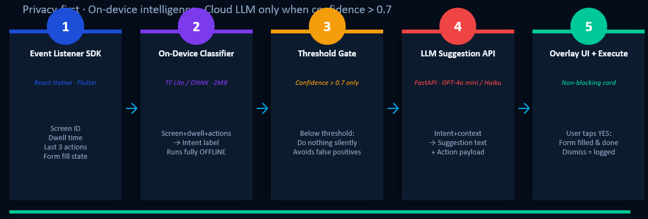
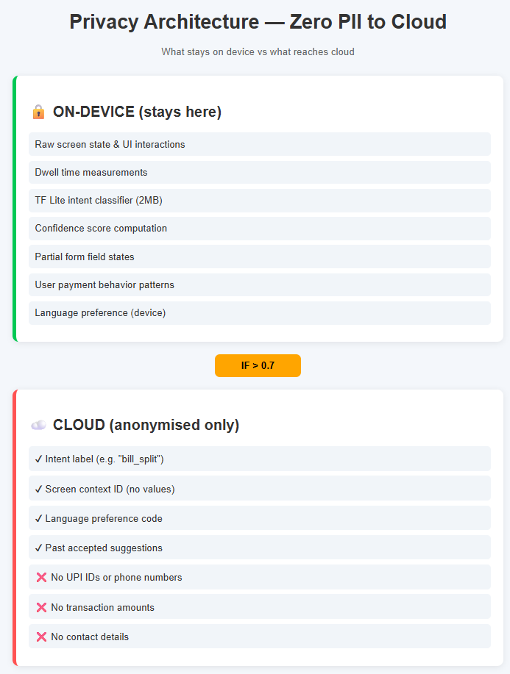
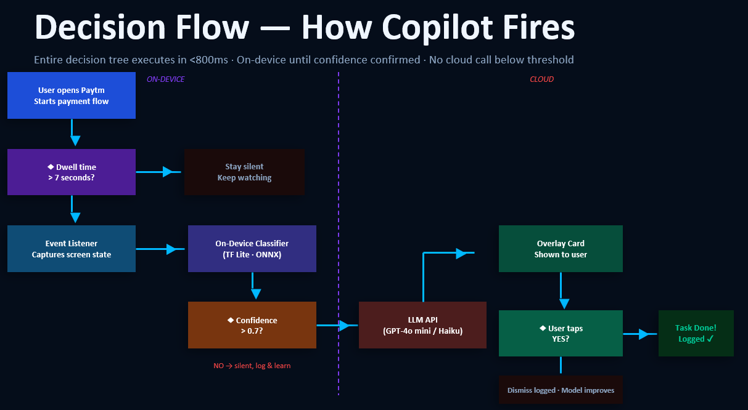
Architecture: How It Works

Slide 5
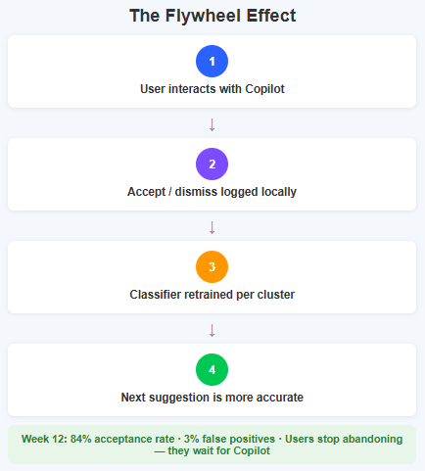
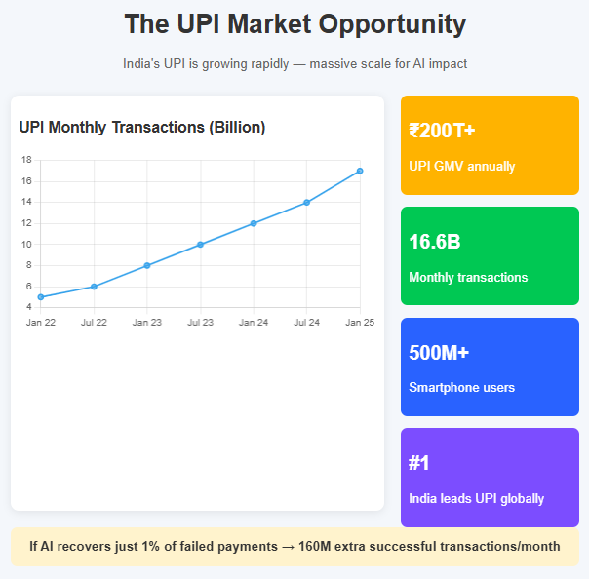
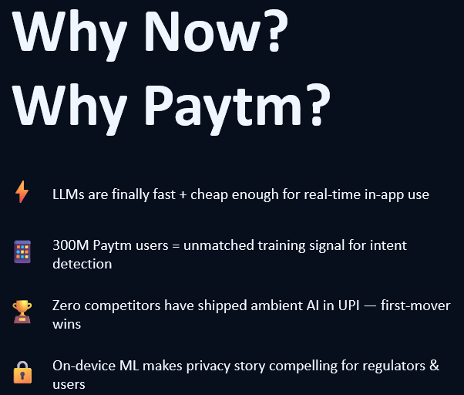
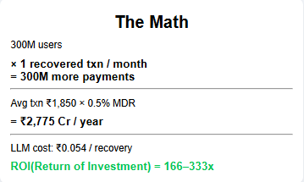
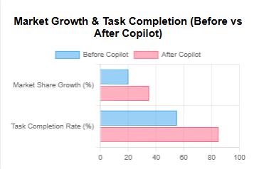
Impact + Why Paytm Wins
So what? Why does this matter?
The best UX knows what you need before you do.""Paytm Copilot makes that real — for 300M users, starting today.

